Slide 1
Hackathon’25 : Solve Rubik’s Cube
© 2025 Collins Aerospace. | Collins Aerospace Proprietary – for internal use only. | This document does not include any export controlled technical data.

Slide 2

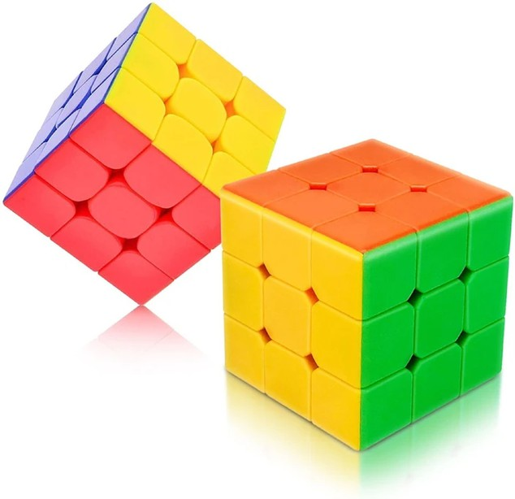
Project Title:
Rubik’s Cube Solver – Design Dexterity Challenge
Presented by:
Utkarsh Singh B.Tech CSE – 1CR22IS175 Email: utsi22ise@cmrit.ac.in LinkedIn: linkedin.com/in/utkarsh746 GitHub: github.com/Anoymous786
© 2025 Collins Aerospace. | Collins Aerospace Proprietary – for internal use only. | This document does not include any export controlled technical data.
https://github.com/Anoymous786/cube.git

Slide 3
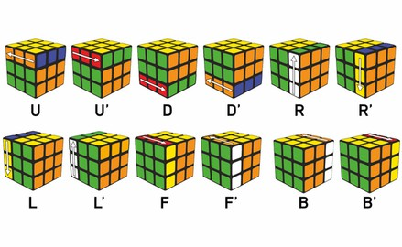

Solve Rubik’s Cube
Overview
Participants are challenged to design and implement an algorithm that can solve a standard 3x3 Rubik’s Cube from any scrambled state. The solution must mimic the real-world logic of solving a cube through a sequence of valid moves.
What We’re Looking For:
🔍 Problem-Solving Approach – How do you break down the problem? How do you model the cube’s state and transitions? 🔍 Use of Data Structures – How do you represent the cube internally (e.g., arrays, trees, graphs)? Use of efficient structures to track states and operations. 🔍 State Prediction Logic – Ability to track and predict cube state after each move. Design of a move engine to simulate rotations and track permutations. 🔍 Algorithm Efficiency – How fast can your solution reach the solved state? Complexity
(time and space) of your algorithm.
Bonus Evaluation Areas: ✨ Creativity in solution design ✨ Visual simulation or cube UI (optional but adds wow factor) ✨ Scalability for different cube sizes (2x2, 4x4, etc.)
Deliverables:
Working algorithm (code)
Brief walkthrough/presentation of your approach Output example(s) from your solver
It’s Not Just a Puzzle - It’s a Test of Mind, Math, and Moves!
https://github.com/Anoymous786/cube.git
© 2025 Collins Aerospace. | Collins Aerospace Proprietary – for internal use only. | This document does not include any export controlled technical data.

Slide 4
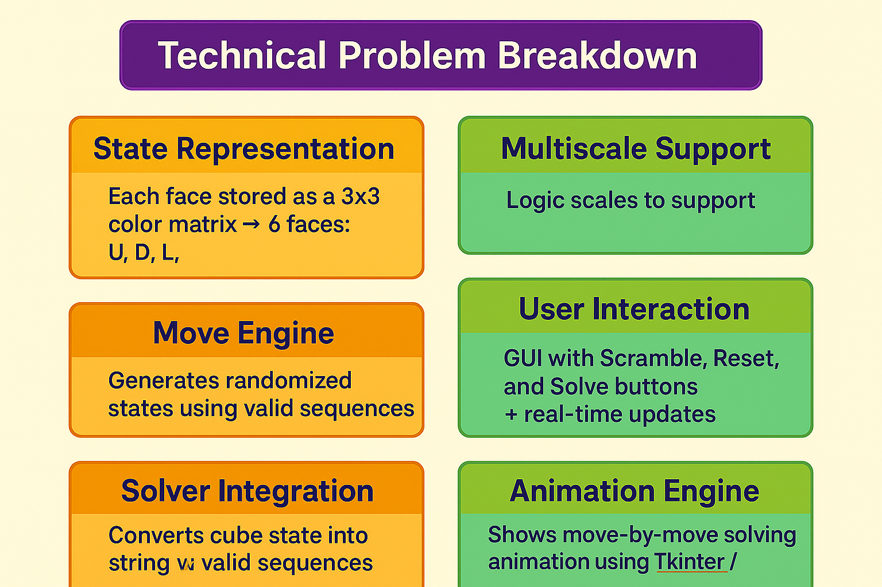
Problem Breakdown :
Solving a Rubik’s Cube manually requires algorithmic knowledge and spatial reasoning. For competitions and educational demonstrations, there is a need to visualize not just the solution but also how the cube transforms at each step. A tool that can both solve and animate the cube would be valuable for learners and evaluators alike.
https://github.com/Anoymous786/cube.git
© 2025 Collins Aerospace. | Collins Aerospace Proprietary – for internal use only. | This document does not include any export controlled technical data.

Slide 5


Problem → Need → Solution
🧩 Problem
Solving a Rubik’s Cube manually is complex, especially for beginners.
Most existing tools are either not visual or don’t support multiple cube sizes.
There’s a lack of intuitive platforms that demonstrate solving steps interactively.
📌 Need
A beginner-friendly tool to both visualize and learn how to solve Rubik’s Cubes.
A solver that shows step-by-step animated moves, not just the final solution.
Support for multiple cube sizes (3x3) in a simple GUI-based application.
💡 Solution
A Python-based application with GUI and animation to solve 3x3 Rubik’s Cubes.
Shows real-time scramble, reset, and solve functionality.
Internally uses Kociemba algorithm and beginner methods, with valid cube state tracking and visual simulation.
© 2025 Collins Aerospace. | Collins Aerospace Proprietary – for internal use only. | This document does not include any export controlled technical data.
https://github.com/Anoymous786/cube.git

Slide 6
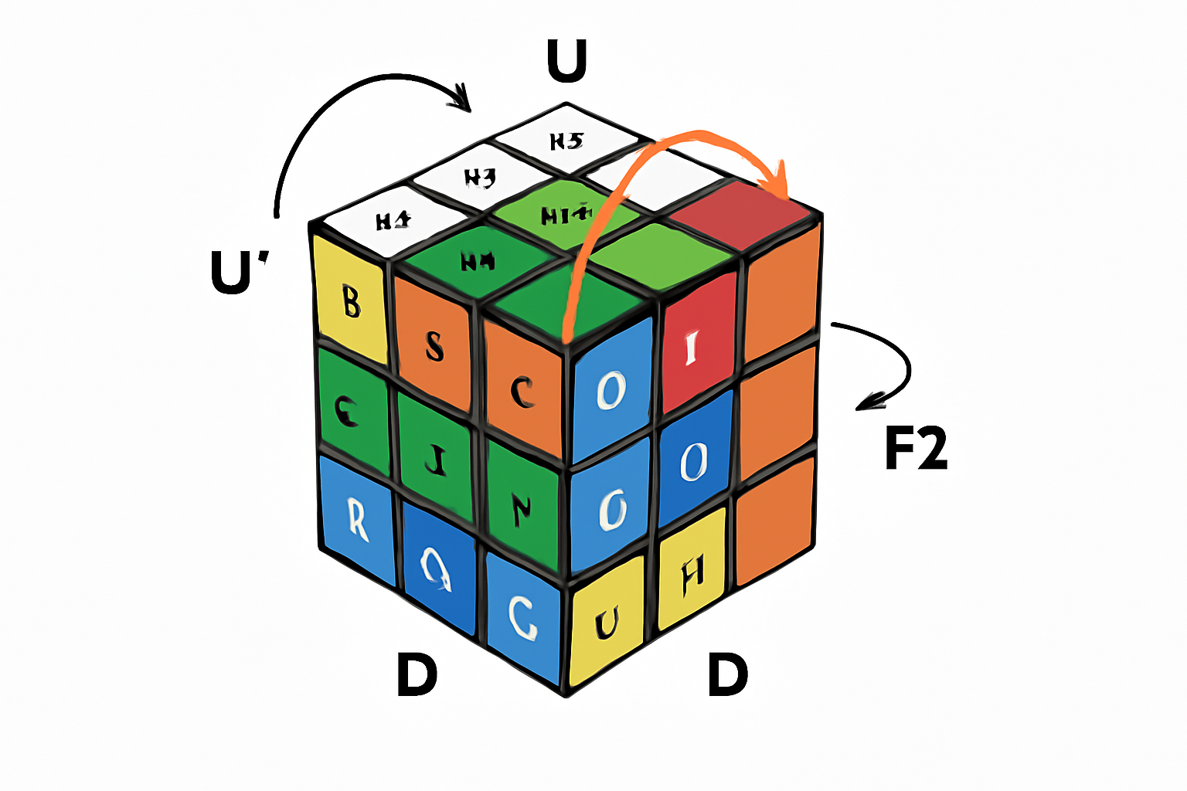
Solution Overview
Scramble, Solve, Reset functions
Real-time 2D animation of each move
GUI built using Tkinter with interactive buttons
Animated cube visuals created using Matplotlib patches
✅ Our Solution (As Implemented)
🔧 Cube class: Handles state, scrambling, face rotations, reset
🧠 Solver logic: Uses Kociemba algorithm for optimal 3×3 solutions
🔁 Animations show step-by-step solving, not just the final state
🔄 Internal state tracked accurately after every move
✅Solving Logic:
Uses Kociemba’s algorithm (only for 3×3)
Cube state converted to Kociemba-compatible string
Solution moves printed and animated step-by-step
https://github.com/Anoymous786/cube.git
© 2025 Collins Aerospace. | Collins Aerospace Proprietary – for internal use only. | This document does not include any export controlled technical data.

Slide 7

🎯 Features
➤ Real-time scrambling and solving with precise move execution and valid cube logic
➤ Fully animated 2D cube visualization using Matplotlib to illustrate each step clearly
➤ Interactive GUI built with Tkinter, featuring easy-to-use buttons: Scramble, Solve, Reset
➤ Internal cube state is accurately tracked after every move for reliable solving
➤ Step-by-step solution displayed both in terminal and through animated cube rotation
➤ Integrated with the Kociemba algorithm for fast and optimal 3×3 solving
➤ Implements only legal Rubik’s Cube rotations, closely mimicking real-world behavior
➤ Clean, modular architecture using cube.py, visual.py, and solver.py for maintainability and clarity
https://github.com/Anoymous786/cube.git

Slide 8
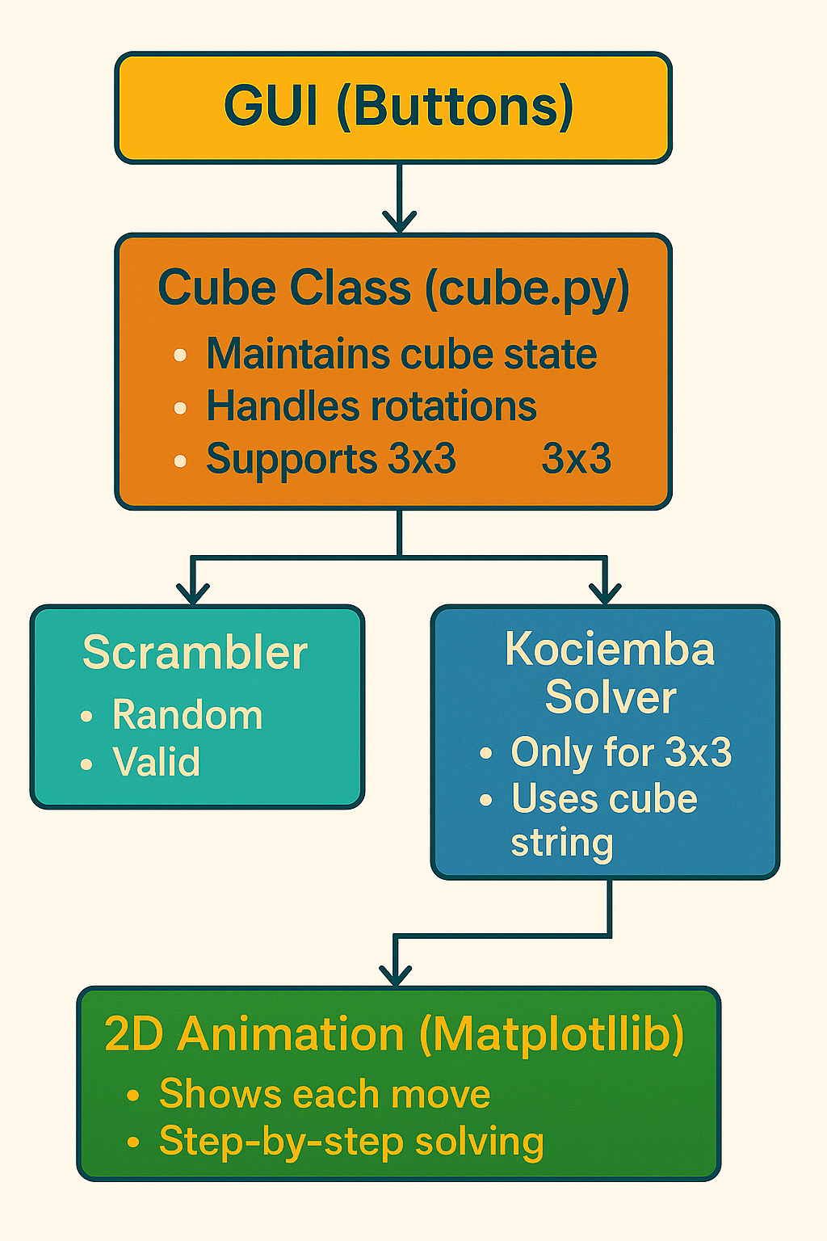

🧩 Project Architecture & Workflow
Module Summary:
• cube.py
➤ Defines Cube class
➤ reset(), move()/_rotate(), scramble(), get_facelet_str(), is_solved()
➤ Maintains and updates the 3×3 cube state
• solver.py
➤ Generates valid scrambles ➤ Converts cube state to Kociemba format and solves it
• visual.py
• app.py
➤ Entry point that imports and starts the GUI loop in visual.py
➤ Connects cube logic, solver, and visualization modules
➤ Builds GUI with Tkinter + ttk theme ➤ Animates scramble and solving steps with Matplotlib facelets ➤ Includes scramble_cube(), solve_cube(), reset_cube()
https://github.com/Anoymous786/cube.git

Slide 9
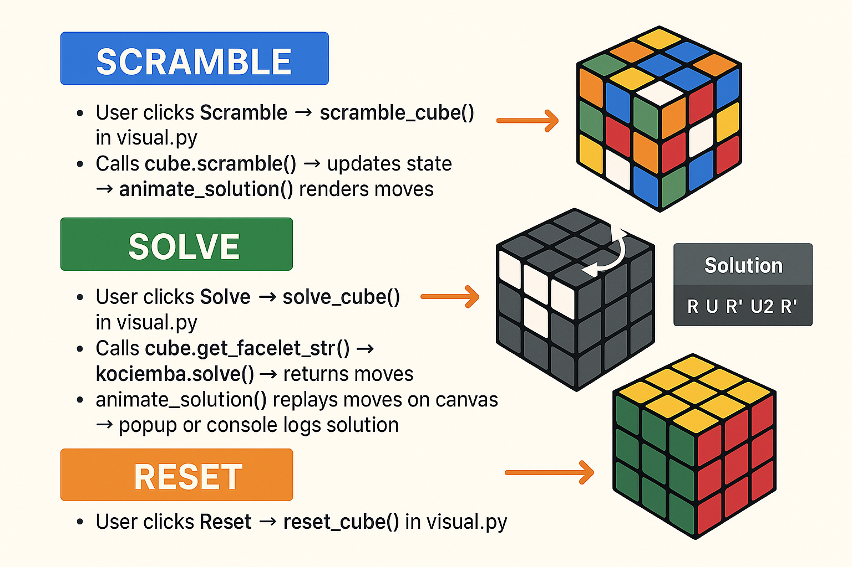

https://github.com/Anoymous786/cube.git

Slide 10
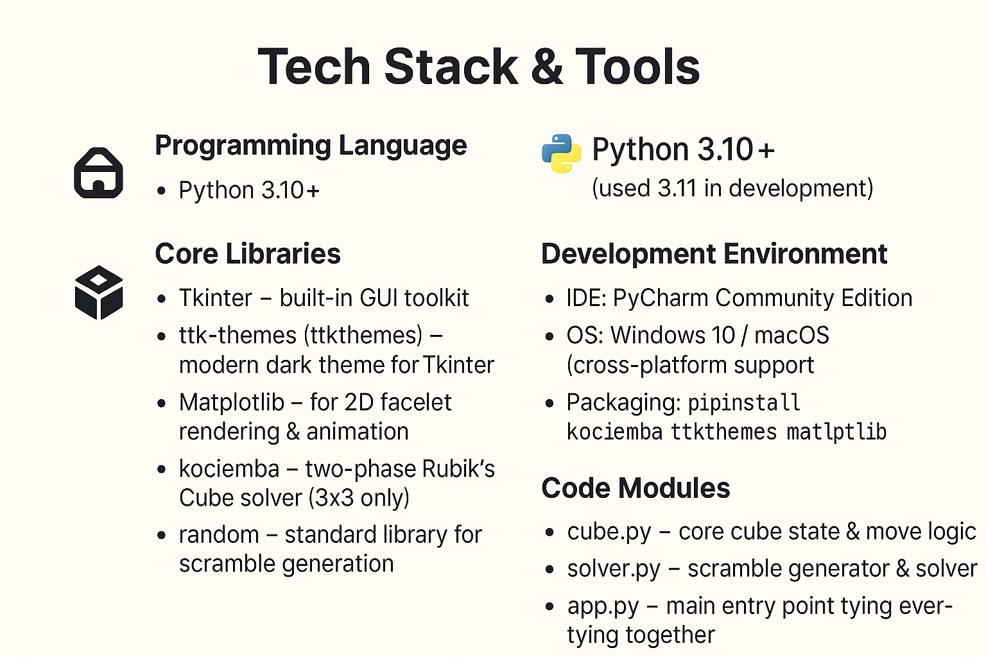

https://github.com/Anoymous786/cube.git

Slide 11
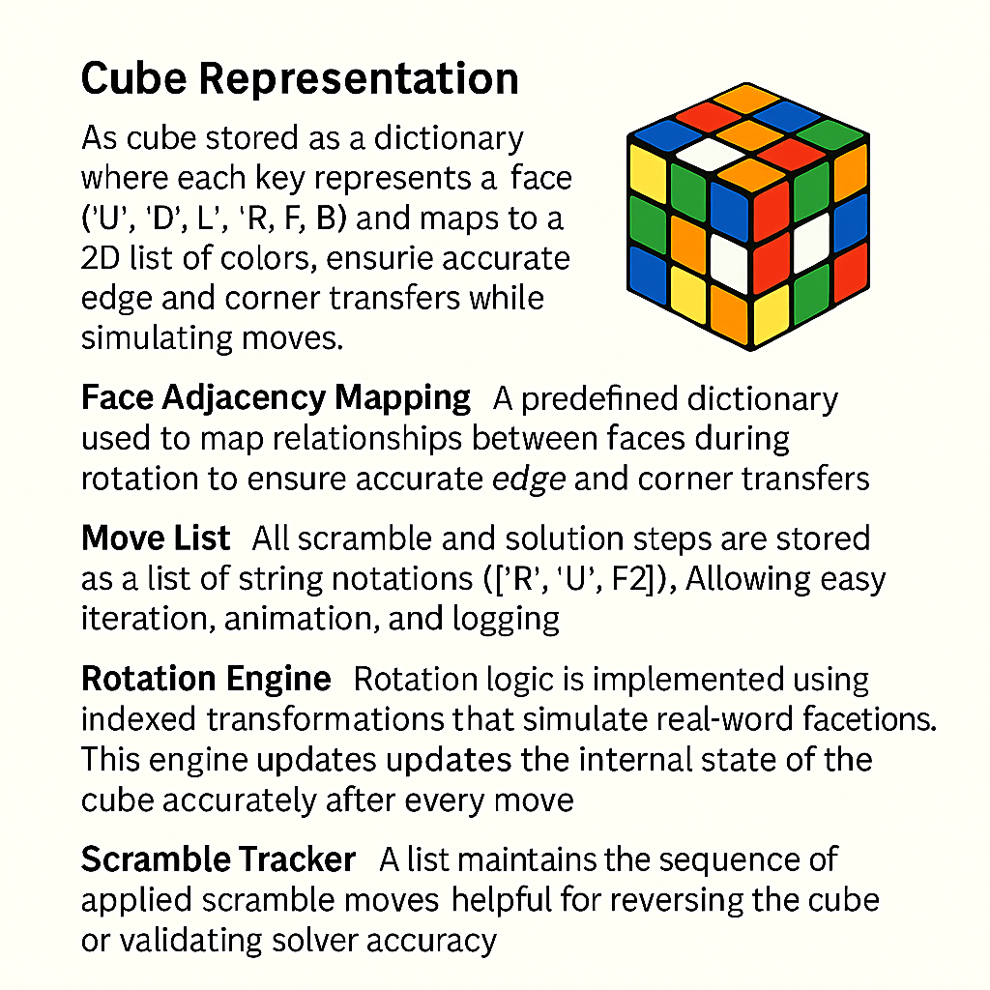
Data Structure used
https://github.com/Anoymous786/cube.git

Slide 12
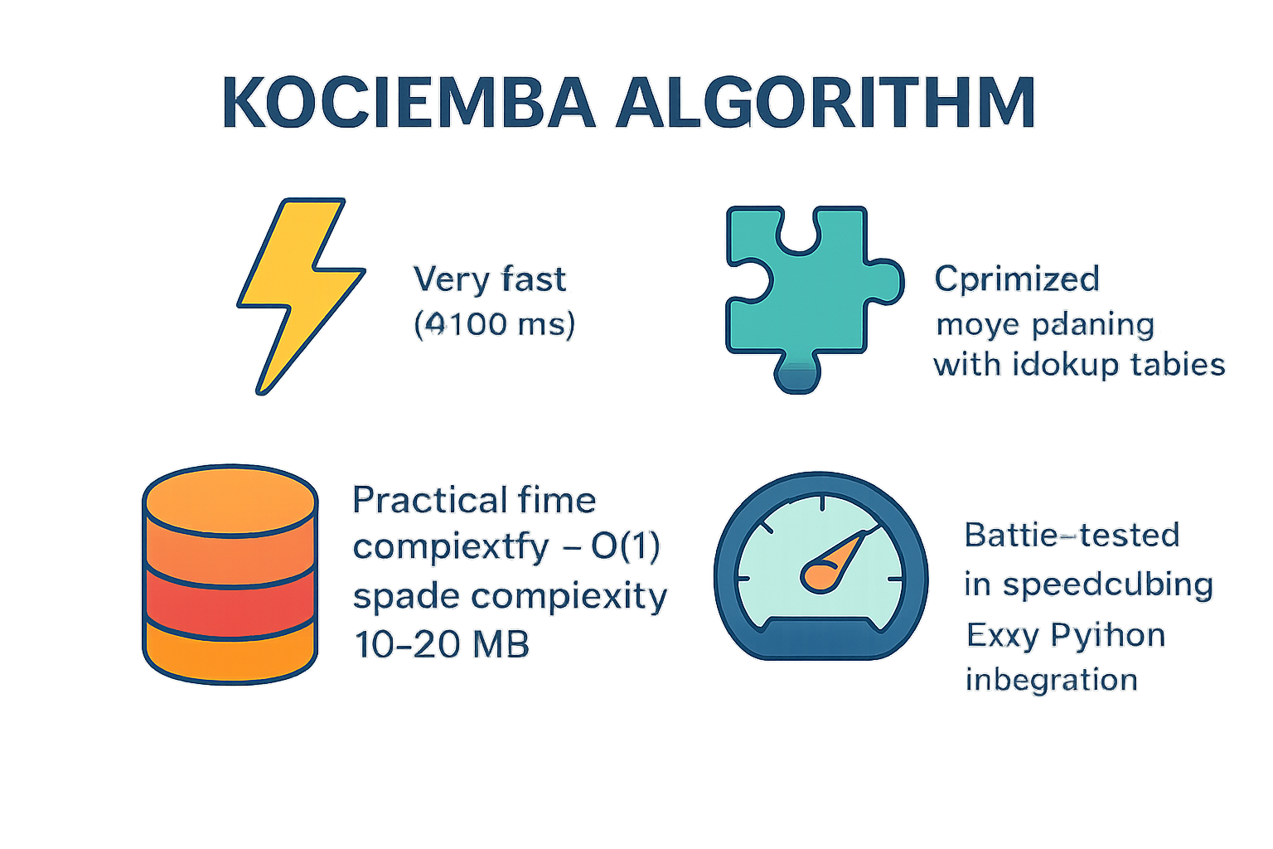

Algorithm, Logic & Efficiency
🧩 Solving Algorithm
Kociemba’s Algorithm:
➤Returns optimal solution (≤20 moves)
➤Uses two-phase search with pruning tables
➤Fast and accurate even for difficult scrambles
🔁 State Transition & Prediction Logic
Cube modeled as 6 face grids (3x3 each)
Each move updates:
Face rotation (3x3 grid)
Adjacent edges and corners
Predicts resultant state accurately after each valid move
🧠 Problem-Solving Approach
Initial scrambled state ➝ Generate cube string ➝ Solve using Kociemba ➝ Apply moves step-by-step with animation
⏱️ Time Complexity
The beginner method follows a fixed step-by-step approach, so each phase takes constant time. Since there are no loops based on input size, overall time complexity is O(1). This means solving steps remain the same regardless of cube state or scramble.
Clear separation of logic: Cube class, Solver, Visualizer
➤
➤
https://github.com/Anoymous786/cube.git

Slide 13

State Prediction Logic
📦 Internal State Representation
a
The cube is stored as a dictionary with 6 faces: U, D, F, B, L, R
Each face is an NxN 2D matrix 3×3
Each cell holds a color (e.g., 'W', 'R', 'G', etc.)
📦 Cube Representation
Cube consists of 6 faces: U (Up), D (Down), L (Left), R (Right), F (Front), B (Back)
Each face is modeled as an N x N grid (e.g., 3x3 for 3x3 cube)
Colors are stored using single-letter codes: W (White), Y (Yellow), R (Red), O (Orange), G (Green), B (Blue)
🔁 Move Execution Logic
Each move like R, U', F2 involves: ✅ Rotating the face matrix ✅ Updating 3–4 adjacent edge strips
Uses:
List reversal and transpose for face rotation
Indexed slicing to handle adjacent edges
🔄 Move Handling Logic
On each move (e.g., R, U', F2):
Rotates the face using matrix rotation (clockwise/anti-clockwise)
Simultaneously updates surrounding edge strips across adjacent faces
Maintains a valid and trackable internal state after each move
📈 Prediction Accuracy
Every move updates the cube state deterministically
Guarantees:
The cube always remains valid
Solver receives correct, current state
✅ Validations Implemented
After each move:
State is verified logically
Visual cube is redrawn for clarity
Full cycle scramble → solve confirms accuracy
https://github.com/Anoymous786/cube.git

Slide 14
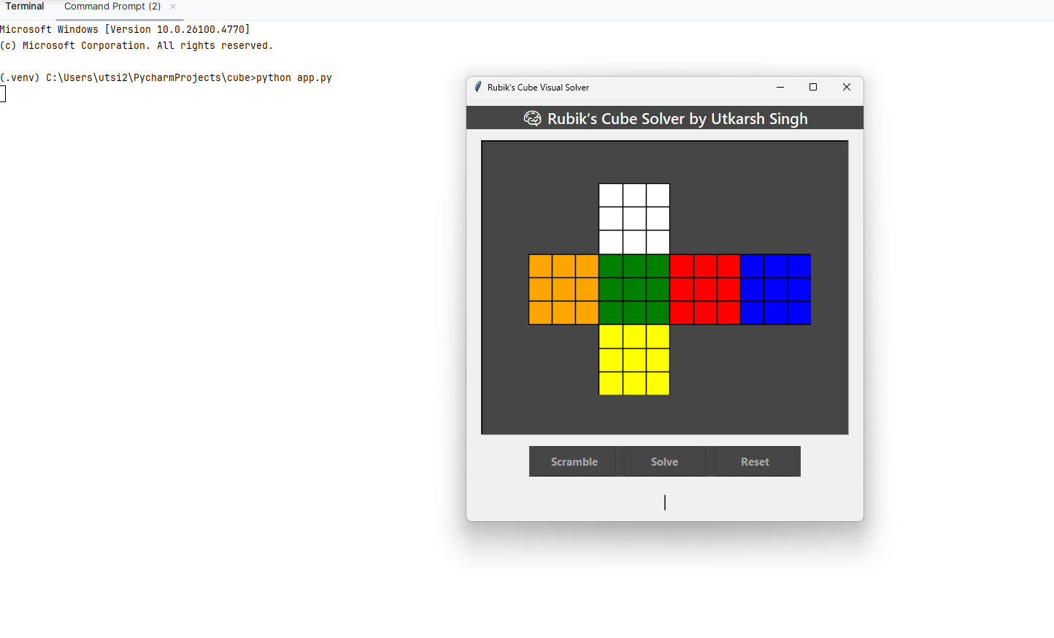
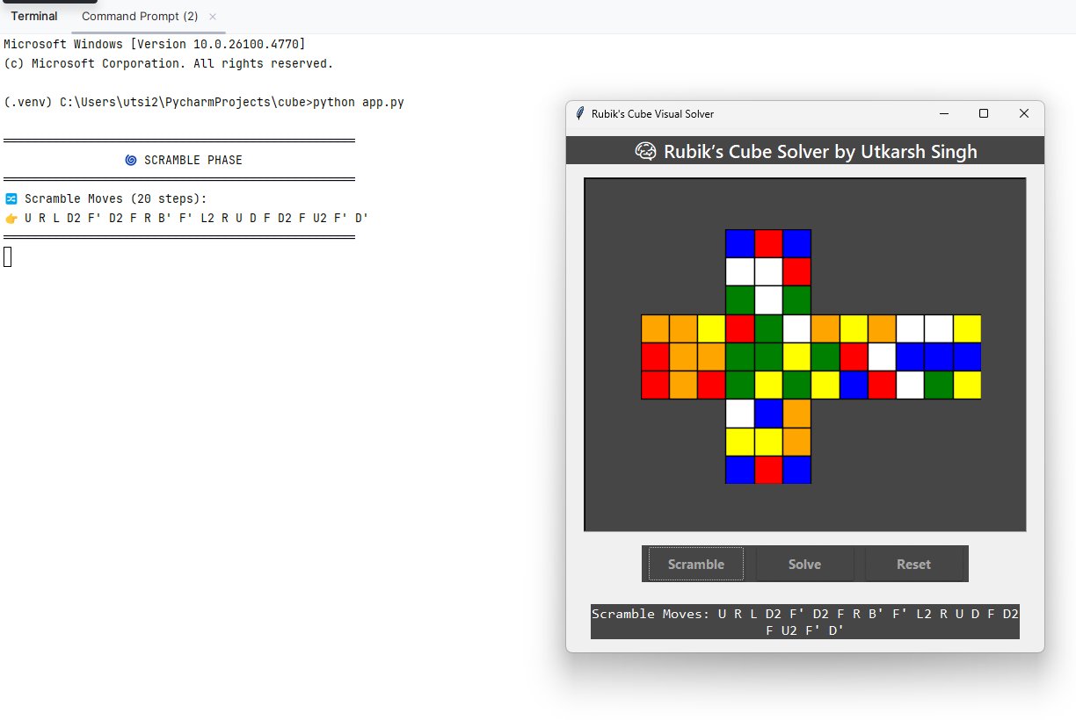

Demo Output & Screenshots
🧩 Real-Time Execution:
Scramble → Randomly shuffles the cube.
Solve → Shows solving steps using Kociemba algorithm.
Reset → Returns cube to solved state.
🖥️ GUI Features:
https://github.com/Anoymous786/cube.git

Slide 15
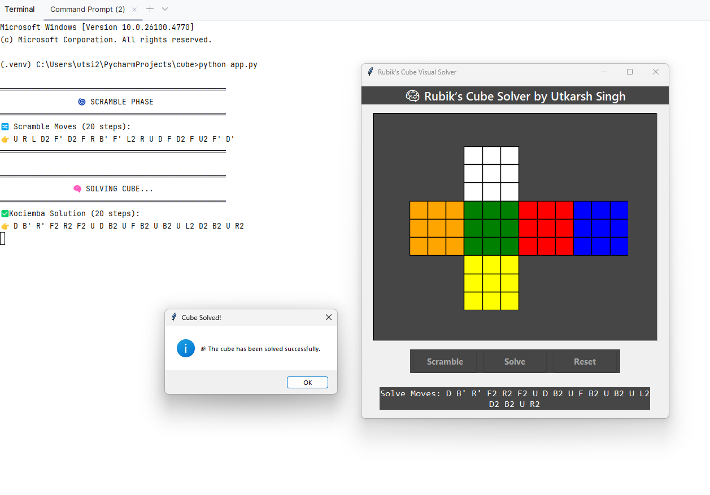

Screenshots
https://github.com/Anoymous786/cube.git

Slide 16
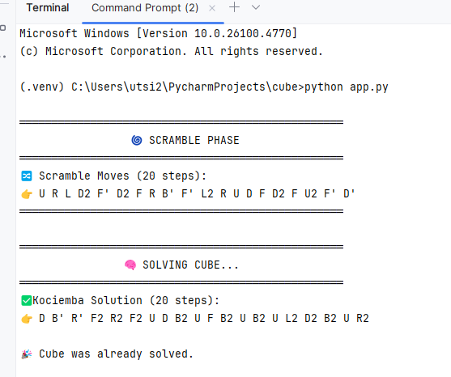

🧩 Real-Time Execution:
The cube supports live scramble, solve, and reset operations through the GUI.
Each move is animated with accurate cube face rotations.
🧾 Explanation
Initial State:
➤ The cube starts in a solved state.
➤ All 6 faces are uniformly colored (White, Yellow, Red, Orange, Blue, Green).
➤ No moves are applied yet.
Scramble Output:
➤ When you click Scramble, a random sequence of valid moves (e.g., U R U' L2) is applied.
➤ The cube’s colors are shuffled visibly.
➤ In the terminal, the scramble steps are printed.
Solve Output:
➤ When you click Solve, the program:
➤ Converts the cube’s state into a string compatible with Kociemba’s algorithm.
➤ Runs the solver and displays the solution steps (e.g., L2 U' R D2 ...) in the terminal.
➤ Simultaneously, the GUI animates each solving move step-by-step.
➤ After all steps are applied, the cube returns to its solved (uniform) state.
Reset Output:
➤ When you click Reset, the cube instantly returns to the solved state, cancelling any scramble/solve actions.
https://github.com/Anoymous786/cube.git

Slide 17
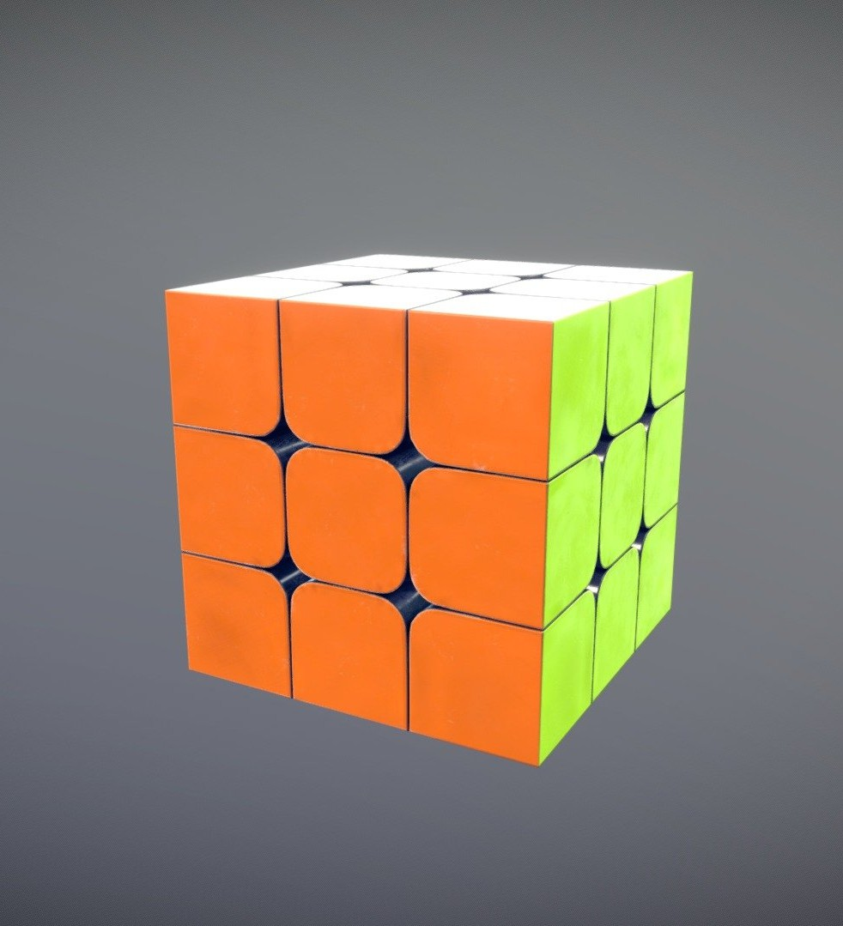

CONCLUSION
The project integrates:
A working Cube logic class that accurately models face rotations and internal state
A solver module that uses the Kociemba Algorithm for optimal 3×3 solutions
A GUI built with Tkinter and Matplotlib, allowing real-time Scramble, Solve, and Reset interactions
Our solver ensures:
Accurate state tracking at every step
Legal and valid cube movements
Clear step-by-step animations to guide learners or evaluators
The system demonstrates:
A modular architecture that is easy to maintain and extend
A visually intuitive solution that helps demystify cube solving for beginners
Strong alignment with the hackathon's focus on problem-solving, algorithm efficiency, and visual clarity
https://github.com/Anoymous786/cube.git

Slide 18

🙏 Thank You!
Project: Rubik’s Cube Solver using Python By: Utkarsh Singh Department of ISE, CMRIT Academic Year: 2024–2025 Event: Hackathon’25 – Collins Aerospace
📩 Email: utsi22ise@cmrit.ac.in 🔗 LinkedIn: linkedin.com/in/utkarsh746 💻 GitHub: github.com/Anoymous786
🧩 Happy to take questions or walk through a live demo
© 2025 Collins Aerospace. | Collins Aerospace Proprietary – for internal use only. | This document does not include any export controlled technical data.
https://github.com/Anoymous786/cube.git

